Slide 1
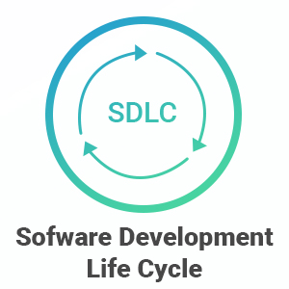

Slide 2
Software Development Life Cycle(SDLC)
Introduction to SDLC :
SDLC has defined its phases as, Requirement gathering, Designing, Coding, Testing, and Maintenance. It is important to adhere to the phases to provide the Product in a systematic manner.
SDLC is the cost-effective and time-efficient process that development teams use to design and build high-quality software. The goal of SDLC is to minimize project risks through forward planning so that software meets customer expectations during production and beyond.

Slide 3
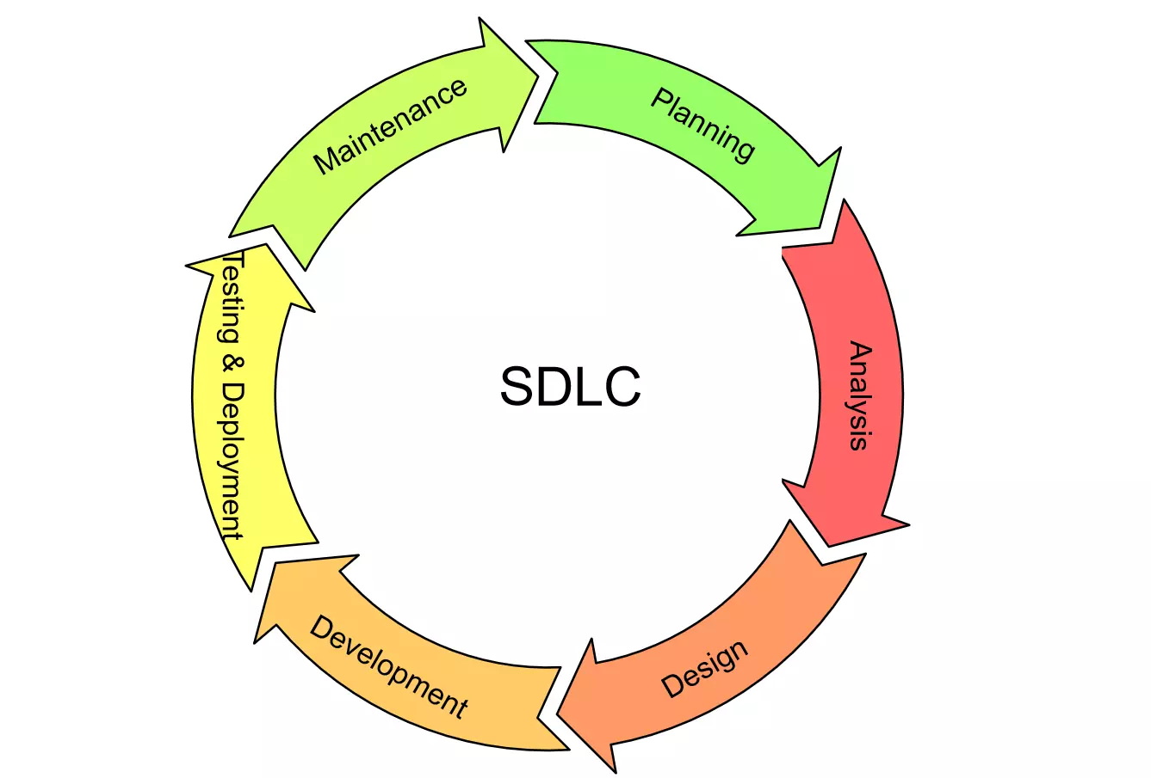
Phases of SDLC

Slide 4
Explain Phases of SDLC
Planning: In this phase, the project's goals, scope, and requirements are defined. It involves identifying project stakeholders, setting a budget, and creating a project plan.
Analysis: During this phase, detailed requirements are gathered from stakeholders, end-users, and subject matter experts. The goal is to understand what the software should do and how it should function.
Design: In this phase, the software's architecture and overall design are created. This includes designing the user interface, data structures, and the technical architecture of the system.

Slide 5
Implementation (Coding): This phase involves writing the actual code for the software based on the design specifications. Developers translate the design into working software using programming languages and tools.
Testing: Software is rigorously tested in this phase to identify and fix any defects, bugs, or issues. Various testing levels, such as unit testing, integration testing, system testing, and user acceptance testing, are performed.
Deployment: Once the software passes testing, it is deployed to a production environment or made available to end-users. This phase can include installation, configuration, and data migration.
Maintenance and Support: After deployment, ongoing maintenance and support are essential to address any issues that arise in the live environment, make updates, and ensure the software remains compatible with evolving technologies.

Slide 6
Common SDLC models
Water Fall Model
Agile Model
Spiral Model
V-Model
Iterative Model

Slide 7
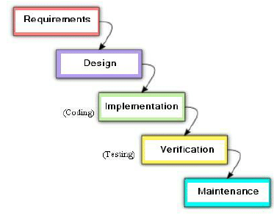
Waterfall Model
The Waterfall model follows a sequential and linear approach to software development.
Each phase must be completed before the next one begins.
It is well-suited for projects with stable and well-defined requirements.
Limited flexibility to accommodate changes once a phase is completed.

Slide 8
Advantages & Disadvantages Waterfall Model
Advantages
Disadvantages
Structured and Easy to Understand
Well-Defined Requirements
Clear Milestones
Stable Product Output
Documentation and Traceability
Rigidity
Limited Customer Involvement
Longer Delivery Time
Higher Risk
Lack of Adaptabillity

Slide 9
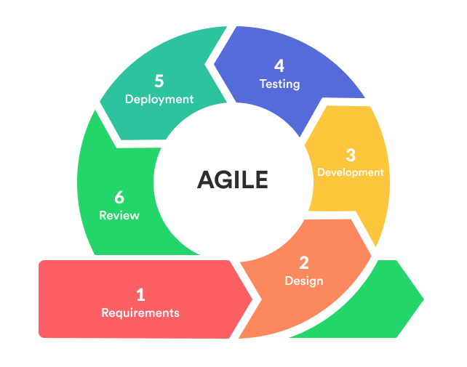
Agile Model:
Agile is an iterative and incremental approach to software development.
It focuses on collaboration, customer feedback, and delivering small, incremental releases.
Well-suited for projects with changing or evolving requirements.
Promotes adaptability and responsiveness to customer needs.

Slide 10
Advantages & Disadvantages Agile
Advantages
Disadvantages
Flexibility
Customer –Centric
Faster Delivery
Continuous Improvement
Reduced Risk
Increased Transparency
Lack of Predictability
Customer Availability
Documentation
Complexity
Scope Creep
Dependency Management

Slide 11
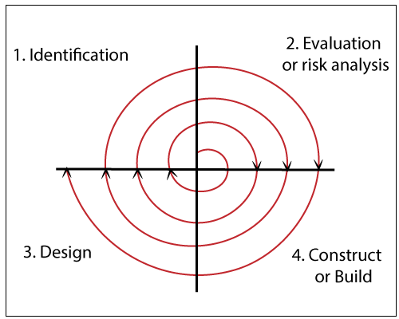
Spiral Model:
The Spiral model combines iterative development with elements of the Waterfall model.
It involves cycles of planning, risk assessment, engineering, and evaluation.
Suited for projects with a high degree of risk or uncertainty.

Slide 12
Advantages & Disadvantages Spiral
Advantages
Disadvantages
Risk Management
Flexibility
Client Involvement
High-Quality Output
Complexity
Resource Intensive
Potentially Longer Timelines
Not Suitable for All Projects

Slide 13
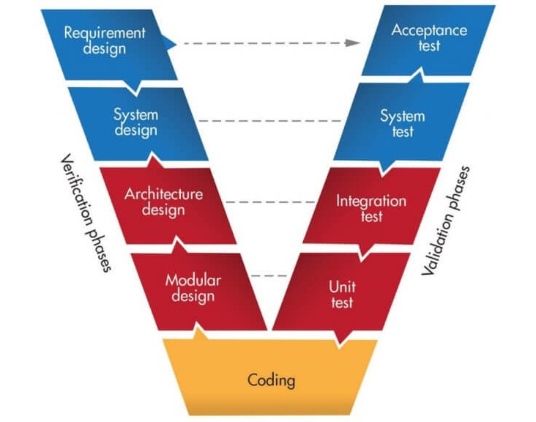
V-Model (Validation and Verification Model)
An extension of the Waterfall model.
Emphasizes the importance of validation and verification at each phase.
Testing is parallel to development.
Ensures that each development stage has a corresponding testing phase.

Slide 14
Advantages & Disadvantages V-Model
Advantages
Disadvantages
Clear and Well-Defined Phases
Strong Emphasis on Testing
Traceability
Predictable Outcomes
Reduced Ambiguity
Rigidity
Sequential Approach
Limited Customer Involvement
Resource –Intensive
Complexity

Slide 15
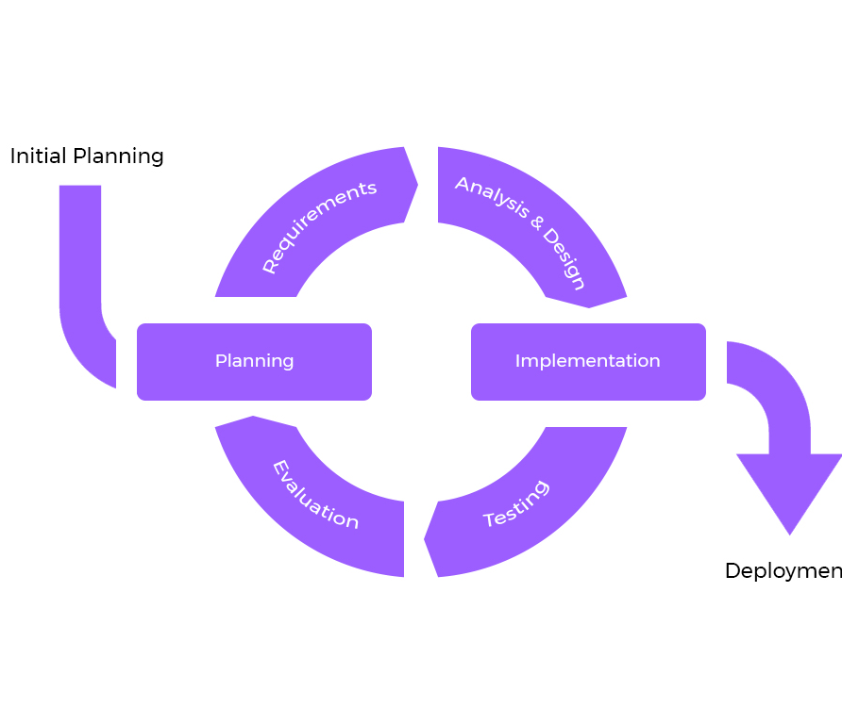
Iterative Model
Repeats the development process in cycles (iterations).
Each iteration adds new features or improvements.
Suitable for projects with evolving or unclear requirements.
Allows for early delivery of a partial product.

Slide 16
Advantages & Disadvantages Iterative Model
Advantages
Disadvantages
Flexibility
Early Deliveries
Continuous Improvement
Risk Reduction
Customer Involvement
Complexity
Resource-Intensive
Continuous Monitoring
Lack of Defined End
Scope Creep

Slide 17
Advantages & Disadvantages SDLC
Advantages
Disadvantages
Improved Planning
Better Quality Assurance
Cost Control
Risk Management
Documentation
Continuous Improvement
Lengthy Timeframes
Upfront Costs
Overhead
Limited User Involvement
Not Ideal for Small Projects
Difficulty Handling Uncertainty

Slide 18
Challenges &Risks SDLC
Challenges
Risks
Changing Requirements
Resource Constraints
Technical Complexity
Communication Issues
Integration Problems
Quality Assurance
Project Delays
Budget Overrun
Technical Risks
Scope Creep
Resource Shortages
Security Thearts

Slide 19
CONCLUSION
In conclusion, the Software Development Life Cycle (SDLC) is a crucial framework that guides the planning, development, testing, deployment, and maintenance of software projects. It serves as a structured roadmap that helps teams and organizations effectively manage the entire software development process.
Structured Approach
Quality Assurance
Project Management
Communication
Risk Management

Slide 20
Questions &Answers

Slide 21
THANK YOU

